Slide 1

(CIS634 Software Engineering Project Presentation) EXPERT SYSTEM FOR SWEAR ANALYSIS
MATHI JESSICA – 2843649
HALAA PRANAVI VANGARA – 2837402
SAHITHI VARMA RAGHAVARAJU- 2837094
NITHIN ARYAN AGRISHETTY- 2837033

Slide 2
DEMO OF THE PROJECT
The project with the expert system for swear analysis format is developed with an intention to help the students do the swear analysis on their own based on certain aspects like Programming, Verbal and other skills needed for the students.
It helps the students to choose their right career paths depending upon availability and their aptitude.
Expert System, is used as a guide for students engaged in their carrier build up based on their paths.
This expert system help us to keep all the human knowledge and thoughts into a computer language.

Slide 3
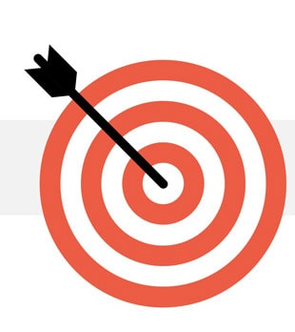
Swear analysis is used to determine the student’s capability of their knowledge, which helps him to know himself how well he can fit into any corporate company according to his skills. The report is based on several basic modules like: programming languages verbal communication and quantitative skills this swear analysis makes students to provide a good carrier guidance in their future path. These also makes them to better understanding where they are lacking behind in the way to their to carreer.
OBJECTIVES

Slide 4
SOFTWARE REQUIREMENT SPECIFICATIONS
The project is about developing an expert system for swear analysis. The system will either be in the form of a chatbot or a graphical user interface (GUI) built with Tkinter. The project is intended to help users understand their performance by providing questions and grades.
The project has three main modules: student information form, verbal, and quantitative. In the student information form, users will input their details. The oral and quantitative modules will test the user's understanding of the material. The project is still in development, and more modules may be added in the future

Slide 5
SOFTWARE DESIGN SPECIFICATIONS
The software architecture of the above project is based on the Model-View-Controller (MVC) pattern.
The Model represents the data, the View represents the graphical user interface, and the Controller represents the logic that handles user input and updates the Model.
The Model is responsible for storing and providing methods to access and update the data. The View is responsible for displaying the data and providing ways for the user to interact with the data. The Controller is responsible for handling user input and updating the Model and View accordingly

Slide 6
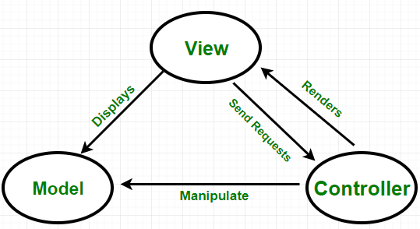
ARCHITECTURal MODEL:

Slide 7
Software Architecture:
The Project has been developed using MVC architecture.
MVC is an architectural pattern consisting of three parts: Model, View, Controller.
Model: Handles data logic.
View: It displays the information from the model to the user.
Controller: It controls the data flow into a model object and updates the view whenever data changes.

Slide 8
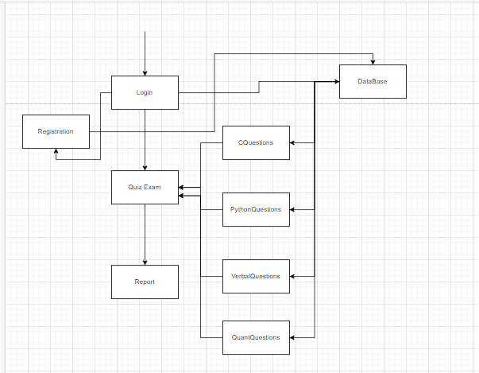
CLASS DIAGRAM

Slide 9
TEST CASES
A copy of the selected test cases will be given to three or four domain experts. The same cases will be introduced to the expert system. Each of the domain experts as well as the expert system will work out the test cases independently

Slide 10
SOURCE CODE

Slide 11
Working of the project
The project has been developed using Python 3.9.7 and MYSQL work bench.
We used libraries like:
Tkinter
Json
Pandas
SQL Connector

Slide 12
Tkinter: It is a standard GUI library for python. Tkinter is a python library that offers a number of functions for creating graphical user interface pages and windows. JSON : It is a standard text-based format for encoding structured data based on javascript object syntax. It is extensively used in web applications to transport data. Sql connector: It enables python programs to access mysql databases and for installing the library we use PIP to install "mysql connector“ Pandas: Pandas is a python library that provides quick, versatile, and expressive data structures for working with "relational" or "labeled" data. Its goal is to serve as the foundation for undertaking realistic, real-world data analysis in python.

Slide 13
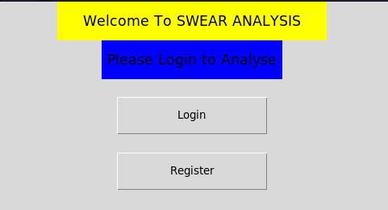
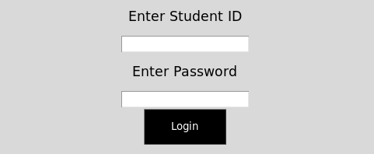
Login(Student)
To proceed into the project you have to log in/register.

Slide 14
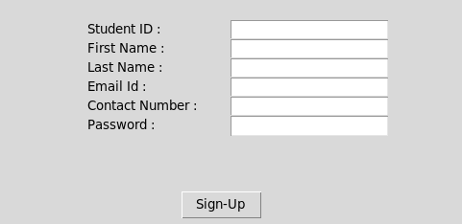
Registration Form
When Registration is clicked, it presents a form for filling in details to register into the software:
After registration you’ll be taken back to login.

Slide 15
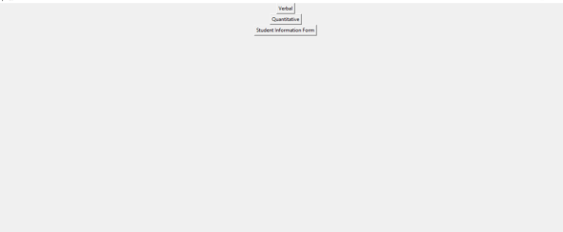
Add more Details
After logging in , you have to add more details.Click the button to proceed.
Student information details

Slide 16
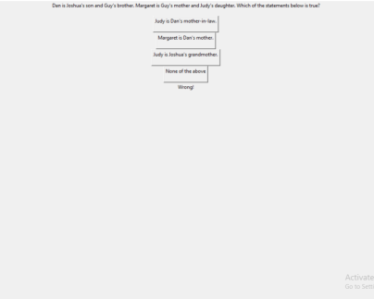
Selecting modules and quizes
Select modules to interact with :

Slide 17
SCREENSHOTS

Slide 18
Conclusion
At the end of the project a PDF report will be generated which gives the final grading of the student.
This helps the student to know his overall performance and helps him improve himself and choose the right career.

Slide 19



Future Enhancement
We can analyze and increase the accuracy by collecting the data from students and train the data using Machine Learning and apply Artificial Intelligence.

